Slide 1
Cells connected in Series
• When cells are connected in series, the battery voltage is the sum of the individual cell voltages.
• However, battery capacity is equal to individual cell capacity since the same electrical current passes through all the cells (charging and discharging all cells at the same rate)

Slide 2

Cells connected in Series
e.g.,
A battery designed from three 3 V, 10 Ah cells in series will have:
- Nominal Voltage = 3 x 3 V = 9 V
- Nominal Capacity = 1 x 10 Ah = 10 Ah
- Nominal Energy Capacity = 3 x 3 V x 10 Ah 90 Wh

Slide 3
Cells connected in Parallel
When cells are connected in parallel, the battery voltage is equal to the cell's voltage.
However, battery capacity is the sum of the cells' capacities, since the battery current is the sum of all the cell currents

Slide 4
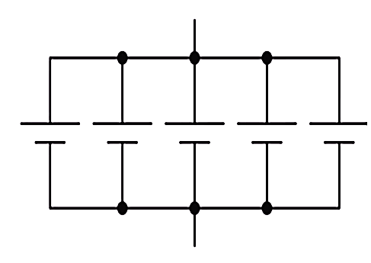
Cells connected in Parallel
E.g.,
A battery designed from five 3 V, 10 Ah cells in
parallel will have:
- Nominal Voltage = 1 x 3 V = 3 V
- Nominal Capacity = 5x 10 Ah = 50 Ah
- Nominal Energy Capacity =
5x3VxlOAh=150Wh

Slide 5
